Slide 1


Self-check 3 Unit check 3
UNIT 3

Slide 2


How much do you remember about colours and meanings they carry? Play this game and find out.
https://wordwall.net/play/849/322/761

Slide 3
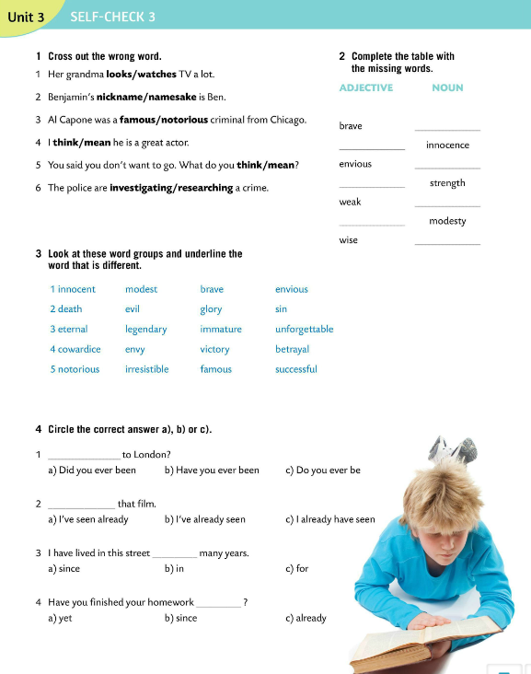
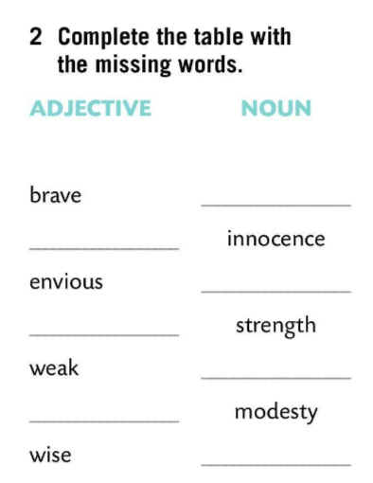
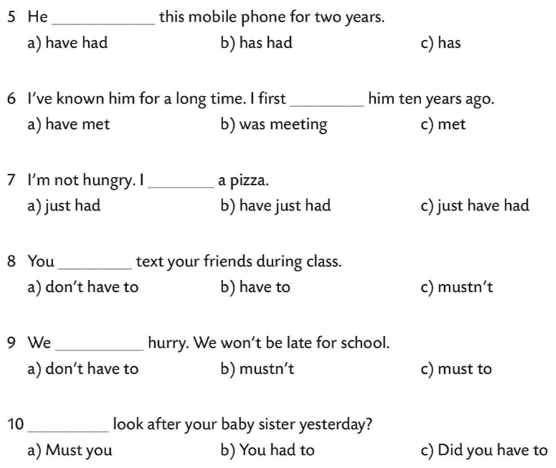
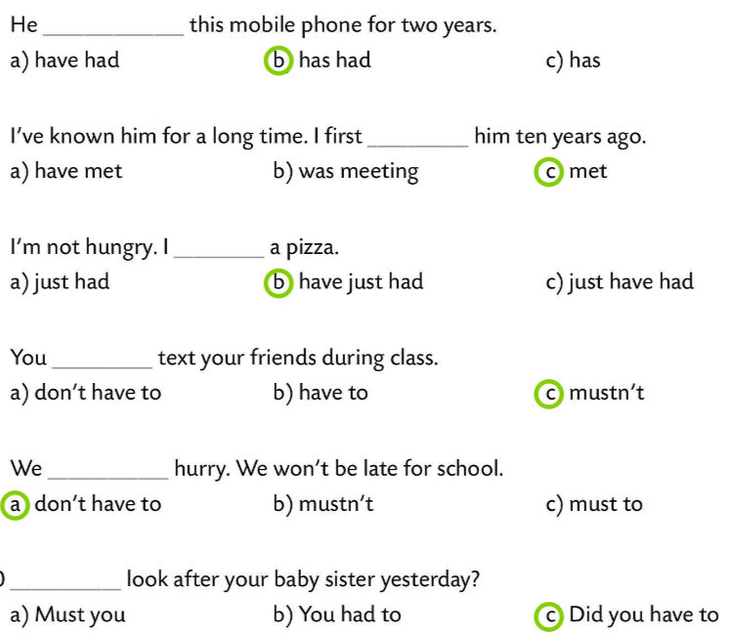
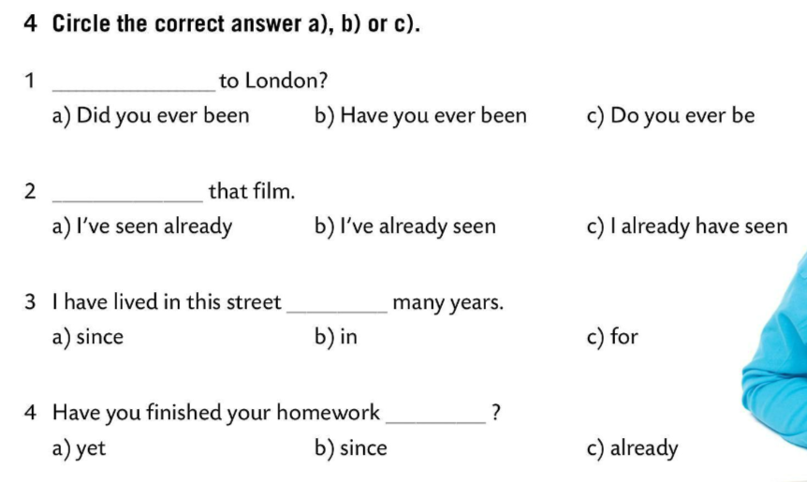
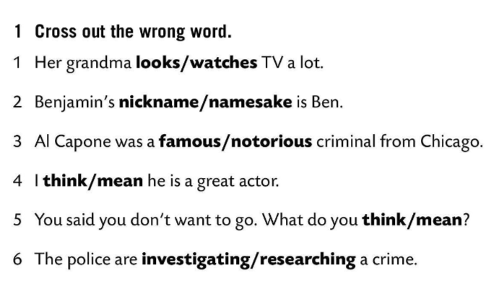
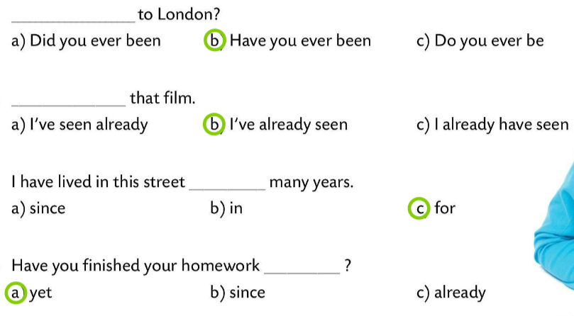
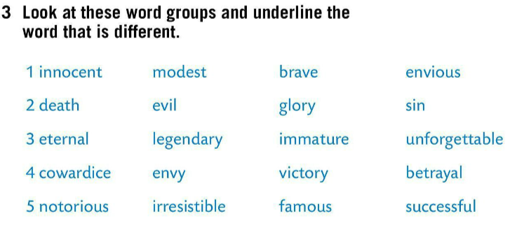
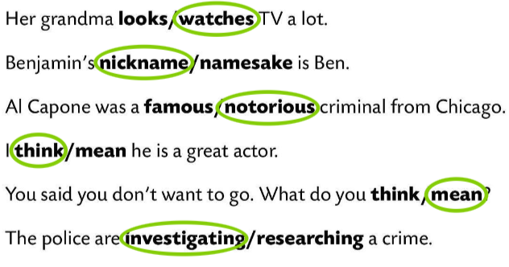
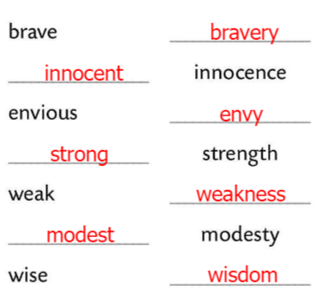
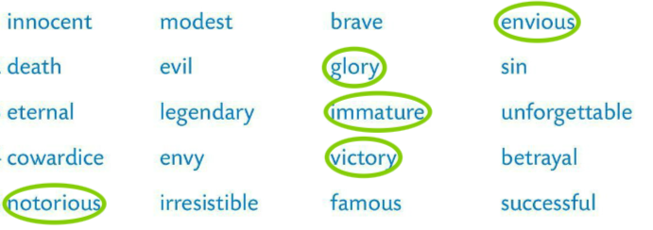
Cross out the wrong word.
Check.
Complete the table with the missing words.
Check.
Look at these word groups and underline the word that is different.
Check.
Circle the correct answer.
Check.

Slide 4
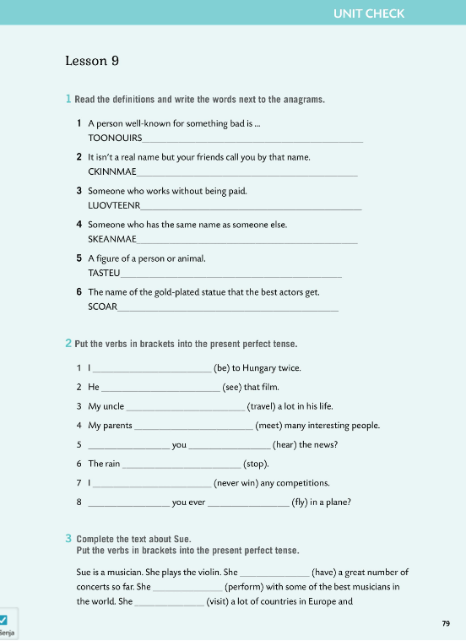

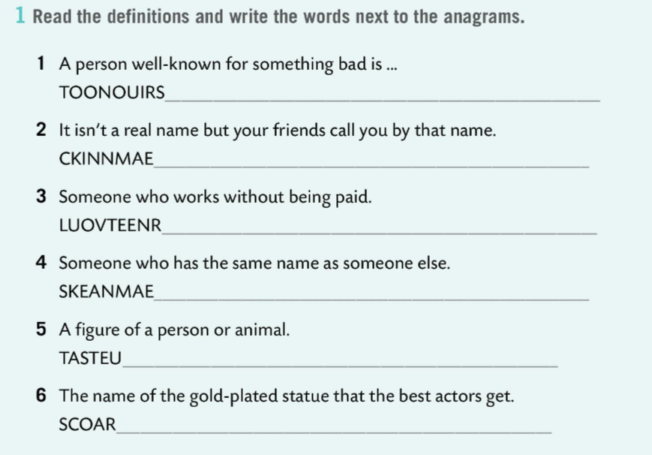
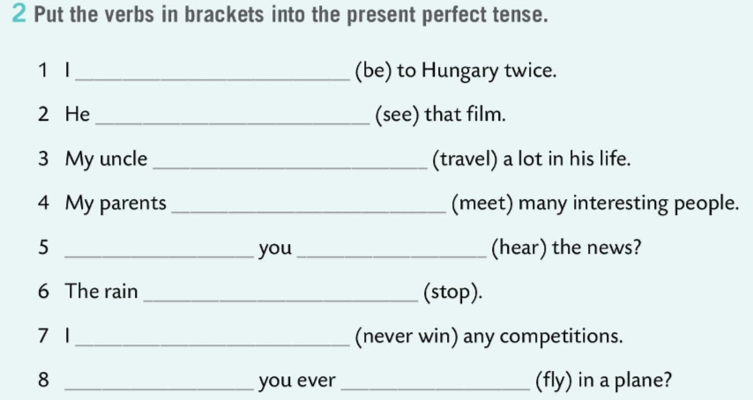
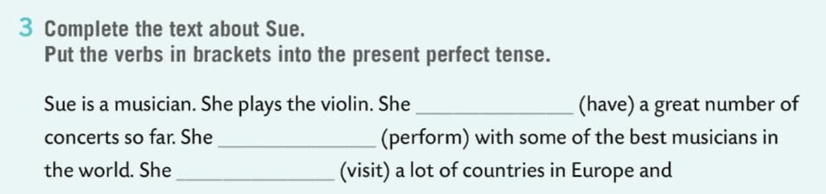
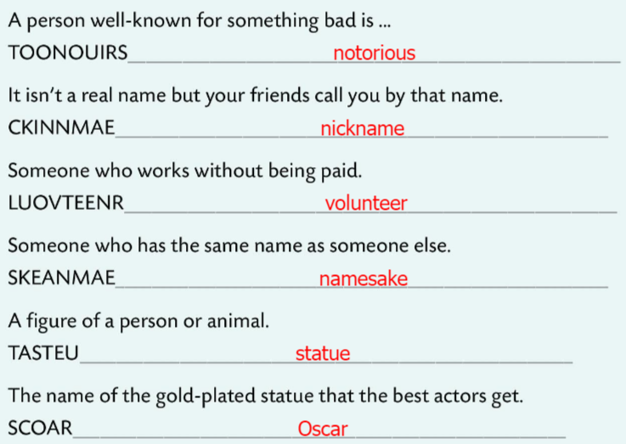
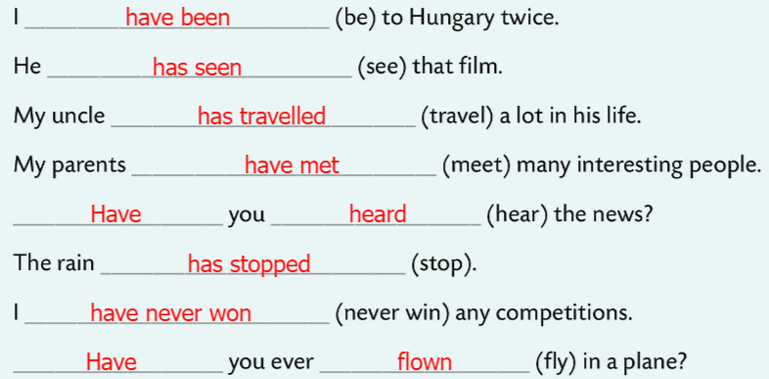
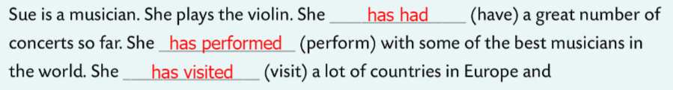
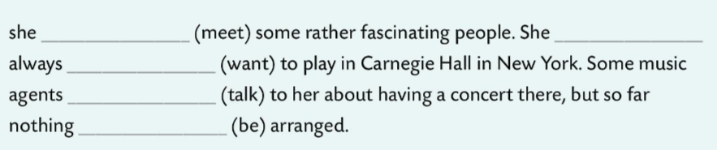
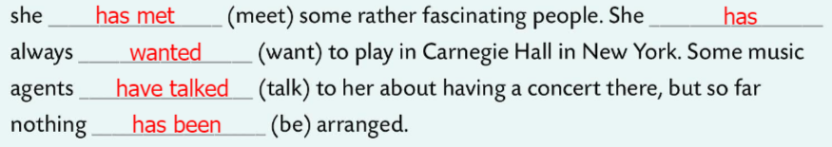
Workbook, page 79 UNIT CHECK 3
Read the definitions and write the words next to the anagrams.
Check.
Put the verbs in brackets into the present perfect tense.
Check.
Complete the text about Sue. Put the verbs in brackets into the present perfect tense.
Check.

Slide 5
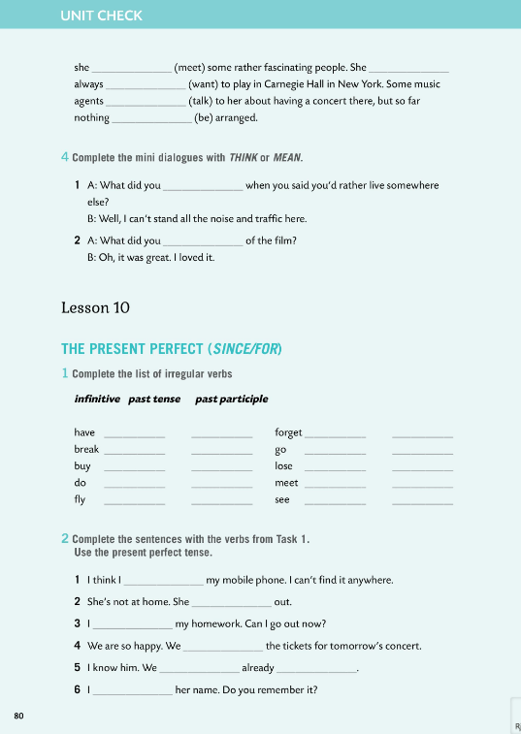
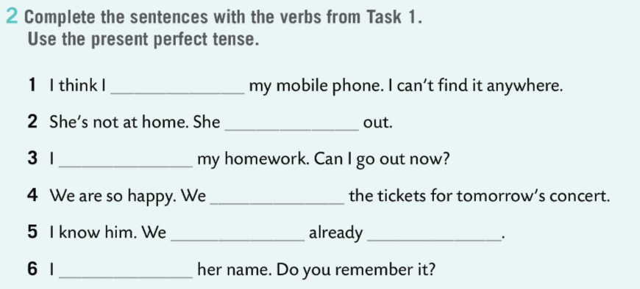
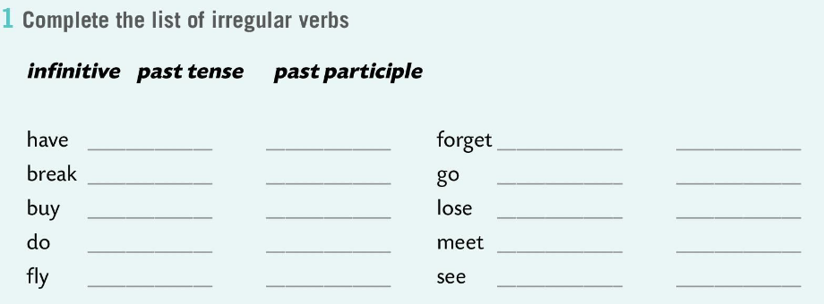
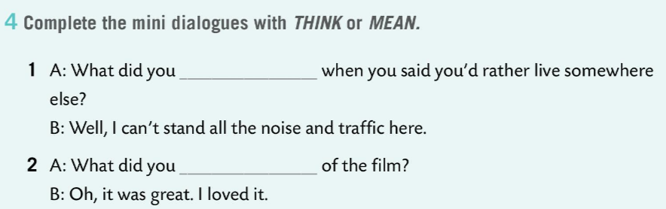
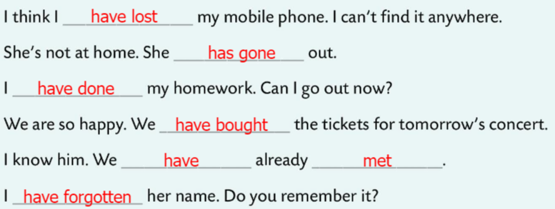
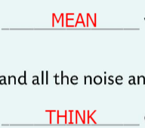
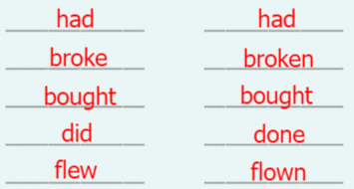
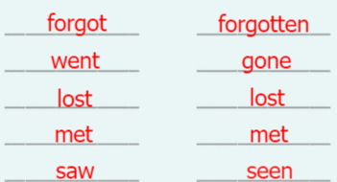
Workbook, page 80 UNIT CHECK 3
Complete the mini dialogues with THINK or MEAN.
Check.
Complete the list of irregular verbs.
Check.
Complete the sentences with the verbs from Task 1. Use the present perfect tense.
Check.

Slide 6
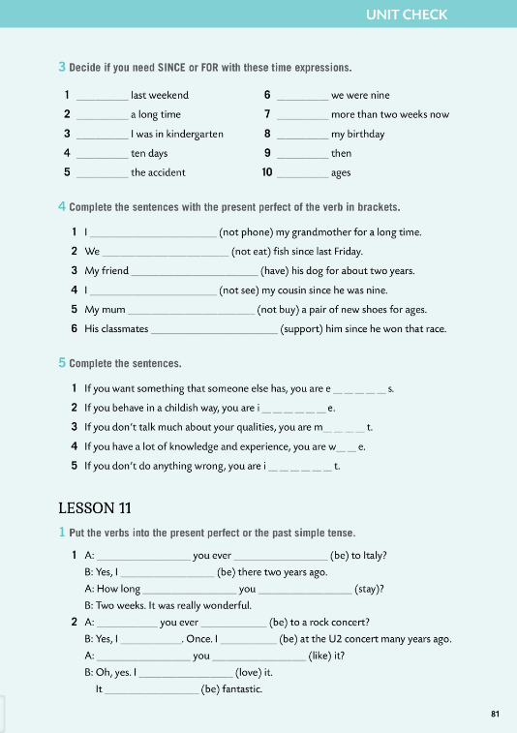
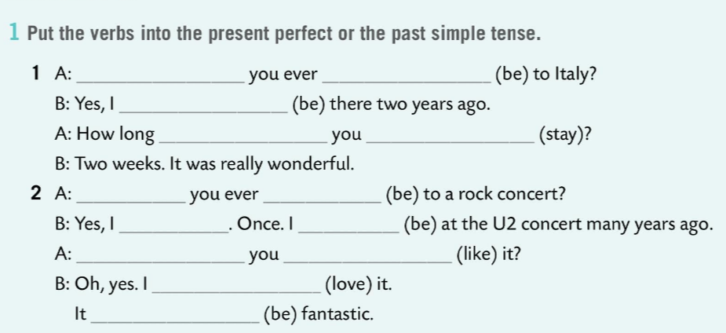
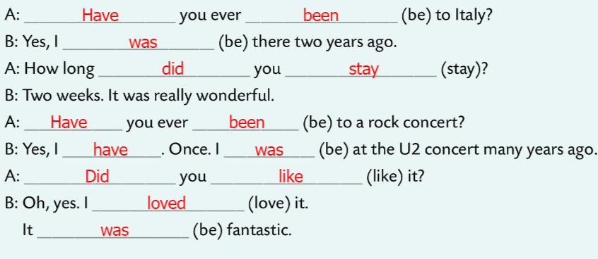
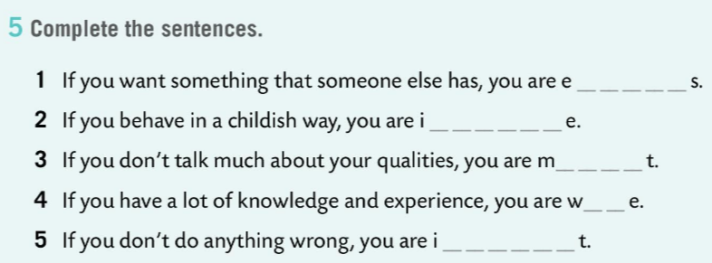
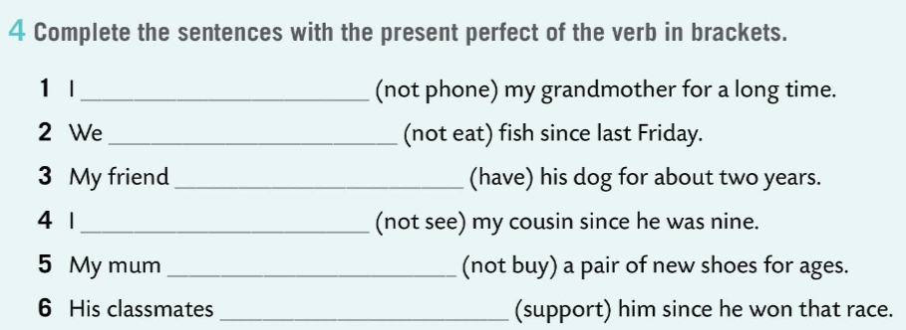
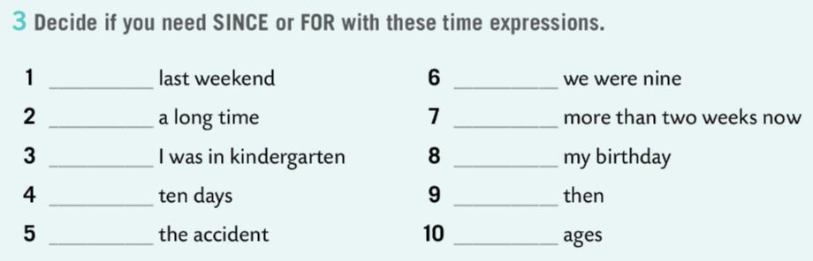
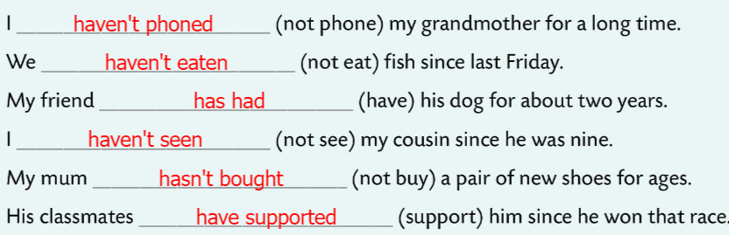
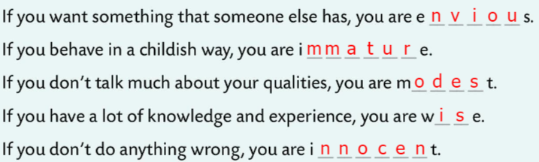
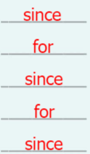
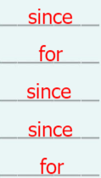
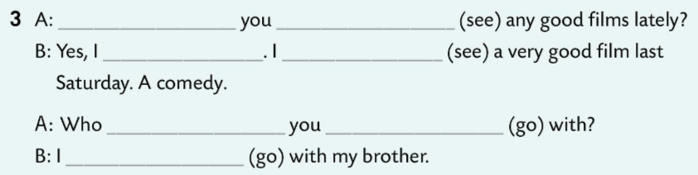
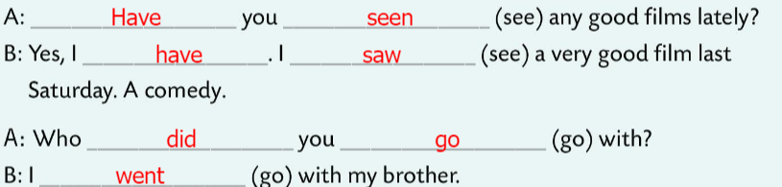
Workbook, page 81 UNIT CHECK 3
Decide if you need SINCE or FOR with these time expressions.
Check.
Complete the sentences with the present perfect of the verb in brackets.
Check.
Complete the sentences.
Check.
Put the verbs into the present perfect or the past simple tense.

Slide 7
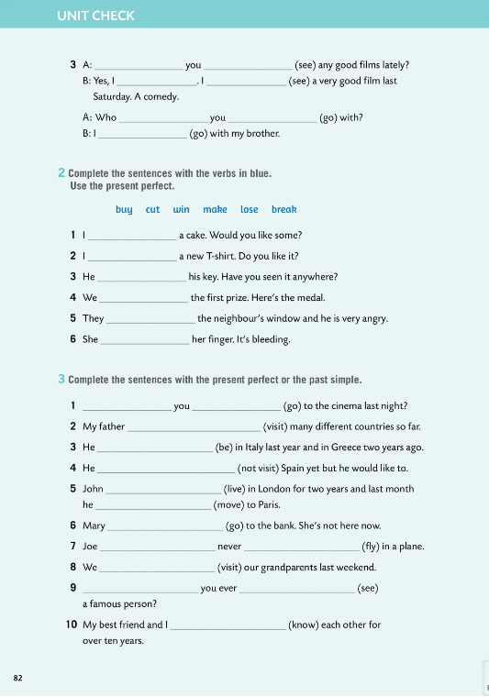
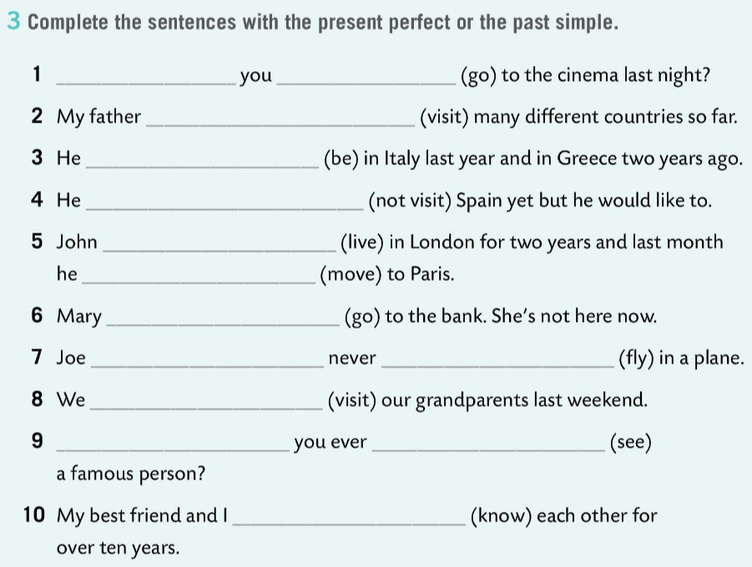
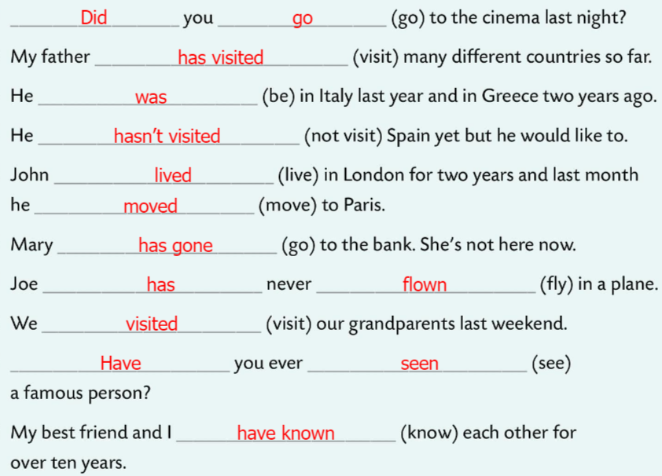
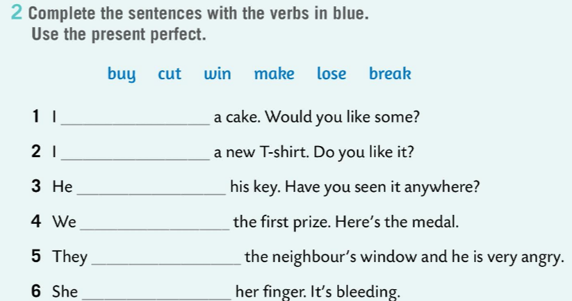
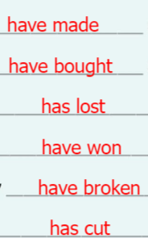
Workbook, page 82 UNIT CHECK 3
Complete the sentences with the verbs in blue.
Use the present perfect.
Check.
Complete the sentences with the present perfect or the past simple.
Check.

Slide 8
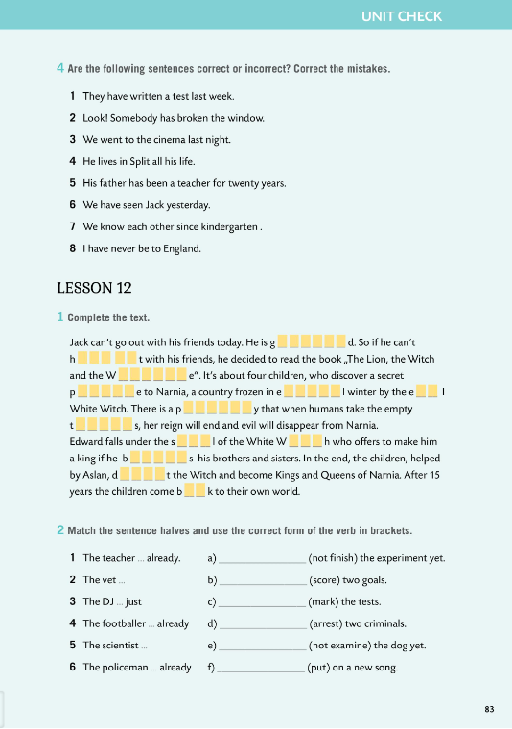
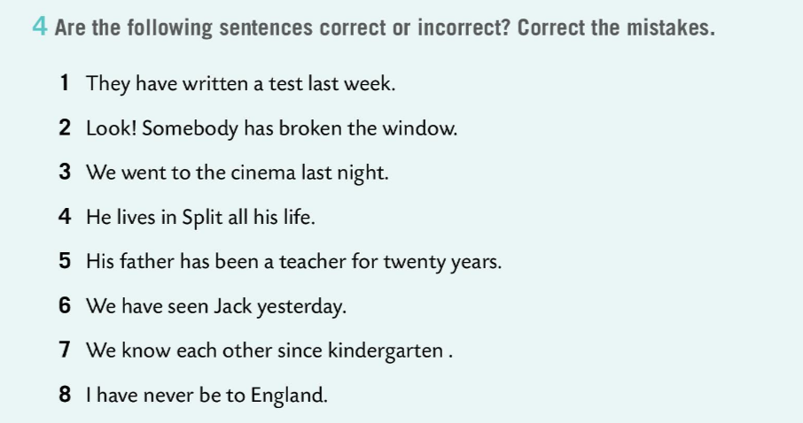
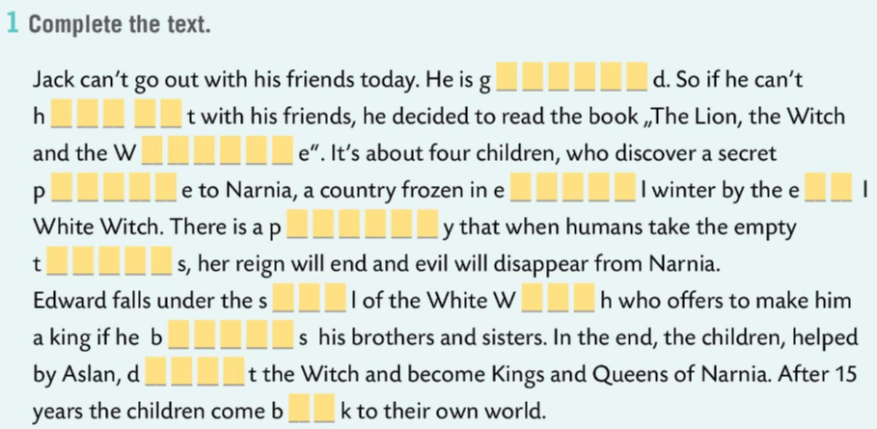
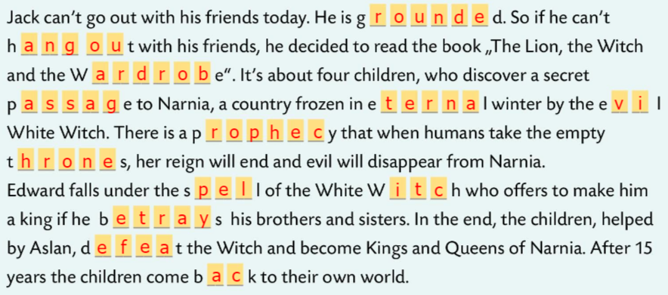
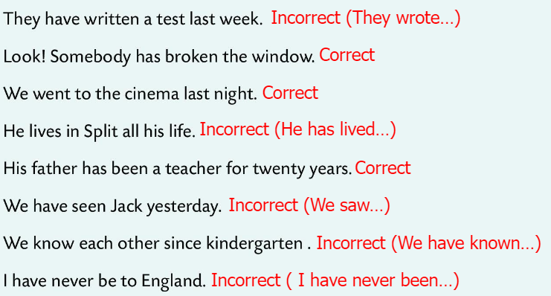


Workbook, page 83 UNIT CHECK 3
Are the following sentences correct or incorrect?
Correct the mistakes.
Check.
Complete the text.
Check.
Match the sentence halves and use the correct form of the verb in brackets.
Check.

Slide 9







Workbook, page 84 UNIT CHECK 3
Write sentences or questions with already, just or yet.
Check.
Use MUST or MUSTN’T
Check.
Complete the sentences with HAVE TO, DON’T HAVE TO, HAD TO.
Check.

Slide 10


Workbook, page 85 UNIT CHECK 3
Tick all the words/expressions you can translate. Look up the others in the word list.
Mark all the adjectives with a little star * and underline all the verbs.
Find 5 words that can be used to describe people and 5 words related to music.
Write down the words/expressions you’d like to remember the most.

Slide 11



Workbook, page 86 UNIT CHECK 3
Tick the statements that are true for you.

Slide 12


Look at the ‘I can…’ table.
Which of the outcomes did you master very well?
Which need more improvement and which need more time and practice?
Be honest and put a tick in the columns based on how well you understood this unit.

